Slide 1

Navigate
Slide A
With Your Class
Which of these variables have we uncovered a mathematical relationship between?
m Δv F Δt
Notes:
Reference the Relationships between variables for 2 colliding objects poster. Present slide A. Give students a half minute to consider the question on their own, then discuss it as a class. See the prompts in the teacher guide for support.
Reference the momentum relationships poster to emphasize that equations we developed only relate two of these types of variables together (m and delta v), but do suggest any mathematical relationship to the other two (F and delta t).

Slide 2
Navigate
Slide B
With Your Class
How can we we use what we figured out about change in momentum (mΔV) to make predictions about the connections to other variables we are interested in?
F the force applied to an object
Δt the time over which the force is applied
Notes:
Consider approaches to use to explore any possible relationships. Present slide B. See the prompts in the teacher guide for support.
Make sure you have a lab setup at the front of the room where students can all see, or have students gather around one of the lab setups in the room.
Orient students to the carts and tracks. Tell students that we don’t have the fancy frictionless cart setup that we saw in the videos, but that we do have some carts, and some tracks. Demonstrate a collision quickly, and then ask, How would we measure the force from that collision if we don’t have the sensors we saw last class? What about the time over which the force is applied? Look for ideas about spring scales, and stop watches.
Problematize the idea of timing the collision. Say, How could we measure the time that the force is being applied here? Demonstrate the collision again.
If the class does not mention that measuring this is too difficult, provide stopwatches to a handful of students to measure Δt. Ask volunteers to share the time they registered. The goal here is simply to identify that measuring this accurately is too difficult given how short the collision time is for elastic collisions.

Slide 3
Considering other forces
Slide C
With your class
Is there another force that we can apply to a single-cart system over a longer period of time to make measuring Δt and F more feasible?
How can we modify our setup to control and measure this type of force interaction?
Notes:
Switch from contact forces to gravity to increase Δt. Present slide C, and ask students to consider if there is another force we could be playing around with that could be applied over a longer period of time to make measuring Δt and F more feasible. If students suggest pushing the cart, point out that then it will be impossible to measure the force. Look for ideas about gravity, or letting the cart roll down a ramp. If these ideas do not come up, suggest, What if we just used gravity, which is already acting on the cart. Then point to the bottom of slide C and ask, How could we modify our setup to control how much gravity is being applied to the cart?
Look for ideas about lifting the cart, using a spring scale, etc. Validate all ideas, and remove one of the carts from the setup at the front of the room.
Lift the ramp to create an incline. Lift the launching ramp and hold the cart 1 foot up the ramp but don’t release it. Ask them to pay attention to how fast the cart moves when it reaches the bottom of the ramp.

Slide 4

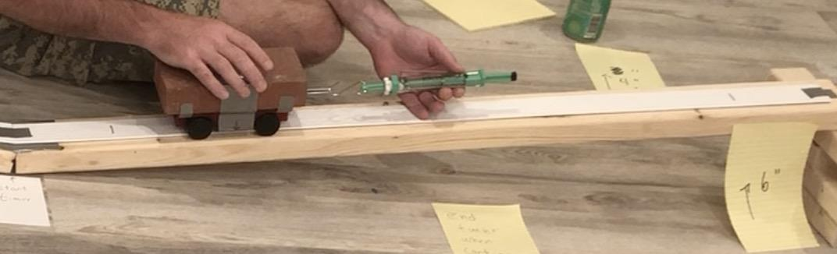
Considering Sources of Error
Slide D
Turn and Talk
Do you believe that momentum will be conserved when the forces are not contact forces?
Why or why not?
Notes:
Consider the shift from contact to distance forces. Show slide D, and give students a moment to turn and talk about the prompt on the slide: Do you believe that momentum for the system will be conserved when the forces are not contact forces? Why or why not?
After a minute, bring students back together and tell them, We aren’t 100% sure if this conservation of momentum thing is true for all forces, or just contact forces. So we cannot assume that the momentum of the system will be the same before and after we let go of the cart. If momentum is being lost from the system though, we want to make sure that the same amount is being lost each time. Since the mass doesn’t change then, we want to make sure the velocity change is always the same.
Explain how to maintain constant change in momentum for each release. Emphasize that a fixed release location on the ramp provides us a way to ensure that equal mass carts will have equal momentum, as long the release height, and ramp angle are the same. Point out the stations around the room that have this ramp setup and suggest that determining whether all of our ramps are using the same release height and mass of cart can help ensure they all are causing the carts at every station to have the same change in momentum by the time they reach the bottom of the ramp. Mention you will provide them with a protocol to make sure the cart is released at the same spot.
Introduce the setup to control the force acting on the cart. Say, In our previous unit, we investigated the forces acting on an object on an incline. and we saw the components of the gravitational force acting on them. If the cart that reaches the bottom of the first ramp then travels up the incline of the second ramp, let’s think about how changing the height of the second ramp would affect the gravitational force acting on it parallel to the ramp.

Slide 5
Mapping the forces
Slide E
With your class
For a cart on an incline:
In what direction will the force of gravity be pulling?
In what direction is the force of gravity balanced by the push up from the ramp?
In what direction is the component of the force of gravity unbalanced, and why is this important?
Notes:
Draw a force diagram and discuss the forces on the cart. Present slide E. On a new piece of chart paper, or on the whiteboard, develop a diagram showing an object on an incline. Use the prompts on the slide to elicit ideas about the force of gravity parallel to the ramp, and the force of gravity perpendicular. Remind students that these are two components of the same force, and that the force is pointed straight toward the center of the Earth. But because we have placed a ramp in the way, only the component of the vector that is unbalanced will transfer energy, and thus be important for motion. The perpendicular component, on the other hand, is balanced by the push upward from the ramp.

Slide 6
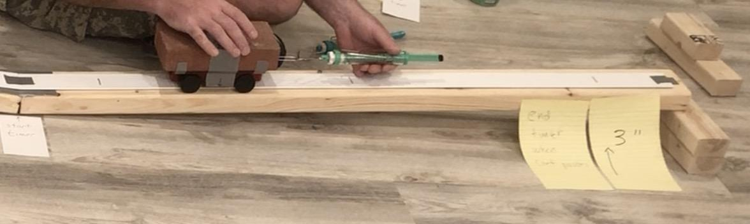
Considering Sources of Error
Slide F
Turn and Talk
What would happen to the magnitude of the unbalanced force component as we increase the angle of the ramp?
Notes:
Present slide F and say, Let’s think about the force along the direction of motion. Give students a minute to turn and talk about the question on the slide: See the prompts in the teacher guide for support.
Summarize the purpose of our experimental setup. Say, So if we keep the height of the first ramp the same, we can control for the force of gravity, and make sure that the change of momentum as the cart comes down is consistent across conditions. And then if we change the height of the second ramp we can manipulate the force the cart experiences here.

Slide 7
Analyze Video
Slide H
With your class
What does the video tell us about how the velocity of the cart changes as it moves up and down the ramp?
Notes:
Say, Let’s watch a slow motion video of a cart going up and down a ramp, to find evidence about the changes in velocity the cart experiences. Present slide H and project the video to elicit student ideas. Look for students to mention the following ideas
The cart slows down on the way up
It speeds up on the way down
There is a point in time where its motion pauses briefly between the two parts and appears to have a velocity close to zero.
Replay the video if the class seems uncertain about different ideas shared during this discussion.
On the board, sketch a graph to reflect these ideas, either linear or nonlinear, as long as it starts positive, passes through zero, and goes negative.
Split the graph into two chunks and focus on the first part. Emphasize that this graph helps us see that the motion of the car has two distinct time chunks, a positive velocity that gets smaller in magnitude as the cart slows down, and a negative velocity that grows in magnitude (even though it is getting more negative) as the cart speeds up. Say, Let’s focus on the first part, where the velocity changes from when it is fastest at the start of the ramp, to where it reaches zero at the top of the ramp.
Mark that velocity change on the graph and say, The velocity has changed over this period of time, so the momentum of the system has changed as well. How could we measure the amount of time it takes for this amount of momentum change to happen? Students might suggest measuring the time at which the cart first starts going up the ramp, up until the point at which it just reaches the highest point in its travel.
Add a marker at the point at which the cart reaches the highest point on the second ramp, and label it with the inclination used. Say, When the ramp is set at this angle, this is the point at which the velocity reaches zero. We can use this marker to get a more accurate time measurement. This marker will provide additional information about the change in momentum of the cart due to the net force acting on it

Slide 8
Analyze Video
Slide I
With your class
What results did everyone get for the time it took for the cart to go from the bottom of the ramp to when the velocity reached zero?
What do we notice across our results?
Notes:
Measure the time the gravitational force acts on the cart. Present slide I. Distribute stopwatches to some students and ask them to measure the time. Repeat the demonstration again, indicating students when you are about to release the cart. Have the students report out the collision time.
Record these times on the board and use them to highlight the difficulty of getting the time perfectly. Suggest we would have to watch really carefully for both points in time - and that this a good opportunity for us to see how accurate such a measure would be from one trial to the next, as well as how accurate our own abilities are in taking such measurements

Slide 9
Considering Sources of Error
Slide J
Scientists cannot eliminate error entirely from their investigations, but they can take steps to reduce it.
What are some possible sources of error in our measurements?
What could we do to reduce the error in our measurements?
If every measurement we collect will have some error:
which value(s) should we use?
which value(s) should we discard?
With your class
Notes:
Discuss sources of error and brainstorm ideas to mitigate it. Present slide J. Use the slide prompts to elicit student ideas. See the prompts in the teacher guide for support.

Slide 10
Discuss Sources of Error
Slide K
With your class
Use CODAP to determine:
The range of our data
The mean value for the time
Data outliers
How can we evaluate the accuracy of our measurements?
Notes:
Introduce CODAP. Present slide K. Say, One way to identify values that are too high or too low is by using a data analysis software. Display the video and show students how to introduce the times they measure in their investigations. Add the time measurements you recorded on the board in CODAP. Then show them how to identify outliers using the “Box Plot” option. Watch the video for a brief tutorial of how to record data and identify outliers using CODAP.
Continue, Let’s use this tool to help identify outliers in the data you collect today, so you can get the most reliable measurement possible. The experiences we gain with CODAP today may give us ideas for how we could reuse it for similar data analysis work in future investigations we design.
Measure the push and pull forces on the ramp at a small inclination. Place a cart in the middle of the second ramp. Use the push bar of the spring scale to hold the cart in the same position. Move the cart upwards very slightly (less than half an inch), and let it fall back on the spring scale. Read out loud the force measurement indicated by the spring scale. Repeat this step a few more times, to point out variation in results. Establish this procedure as the protocol to ensure the spring isn’t getting stuck and giving inaccurate readings.
Measure the push and pull forces on the ramp at a higher inclination. Measure the force on the cart a second time using the spring scale hook. Push the cart upwards very slightly (less than half an inch), and let it move downwards away from the spring scale. Repeat this step a few more times, and compare these values to the force measurements you obtained with the push method to point out variation in results. Establish this second procedure as the protocol to ensure the spring isn’t getting stuck and giving inaccurate readings. Suggest that we average the force readings from both methods, and use this value for our calculations.
Say, We will consider that this average force would be applied parallel to the ramp for the entire time the cart is on the ramp

Slide 11

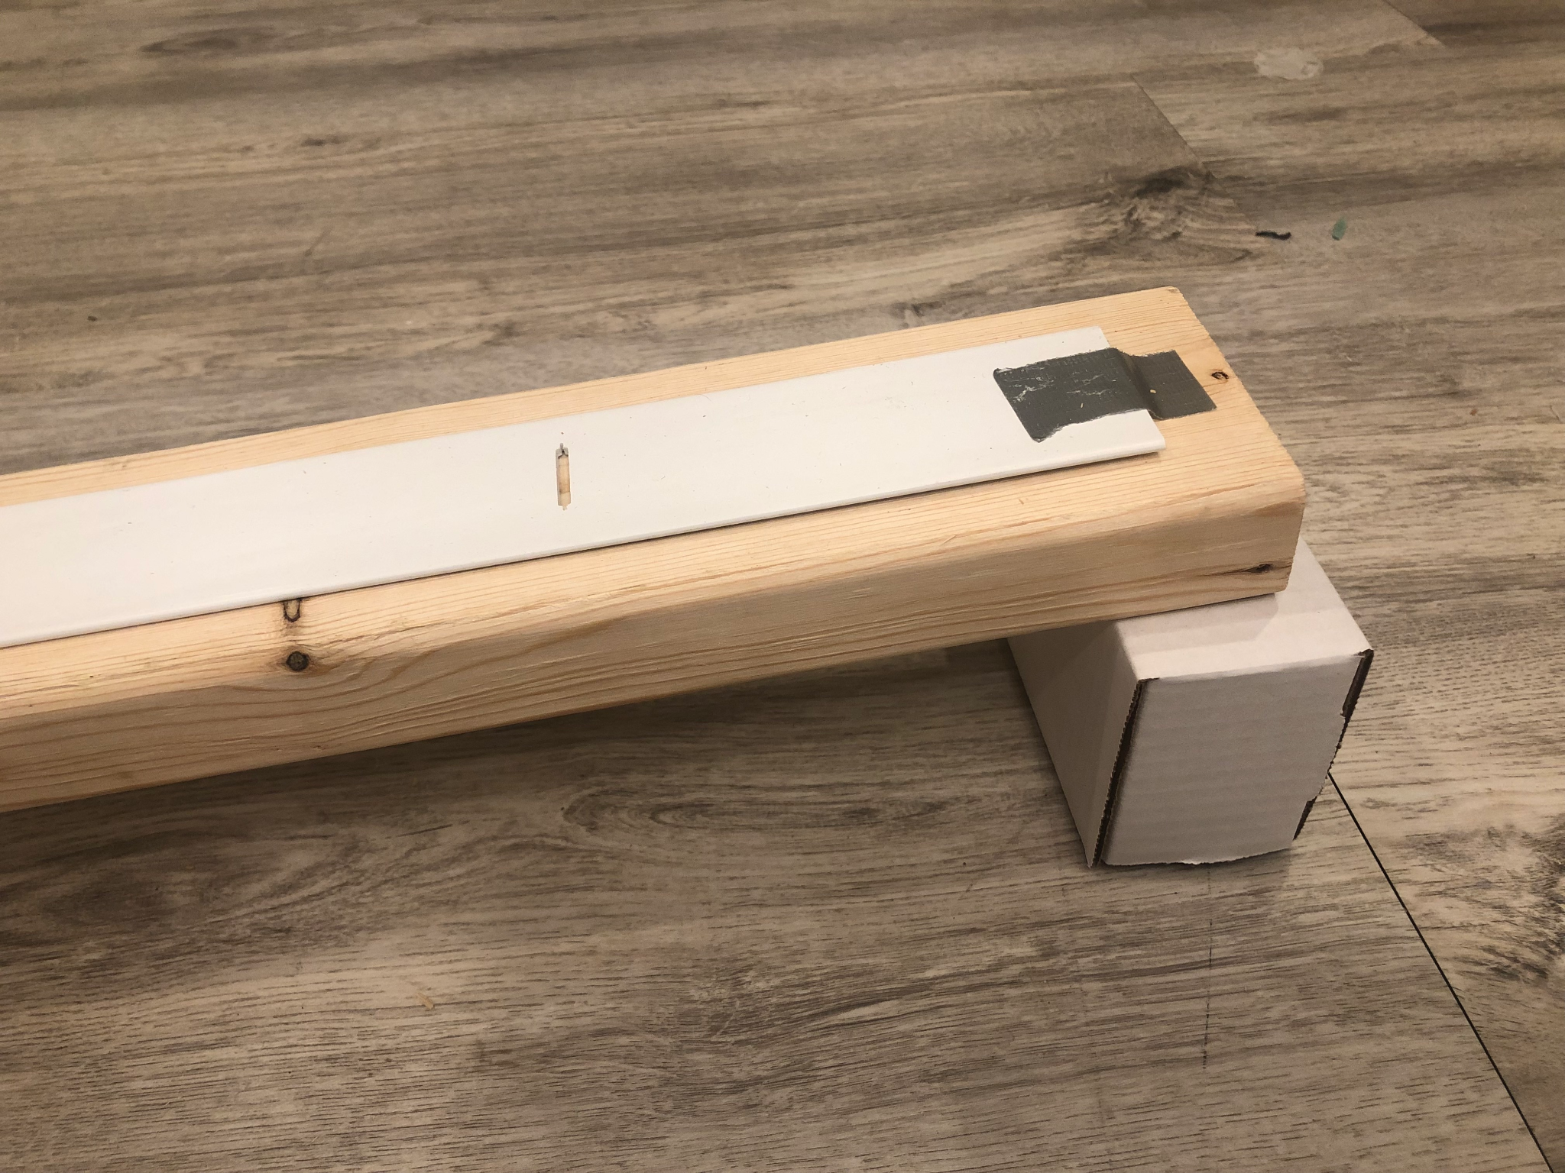
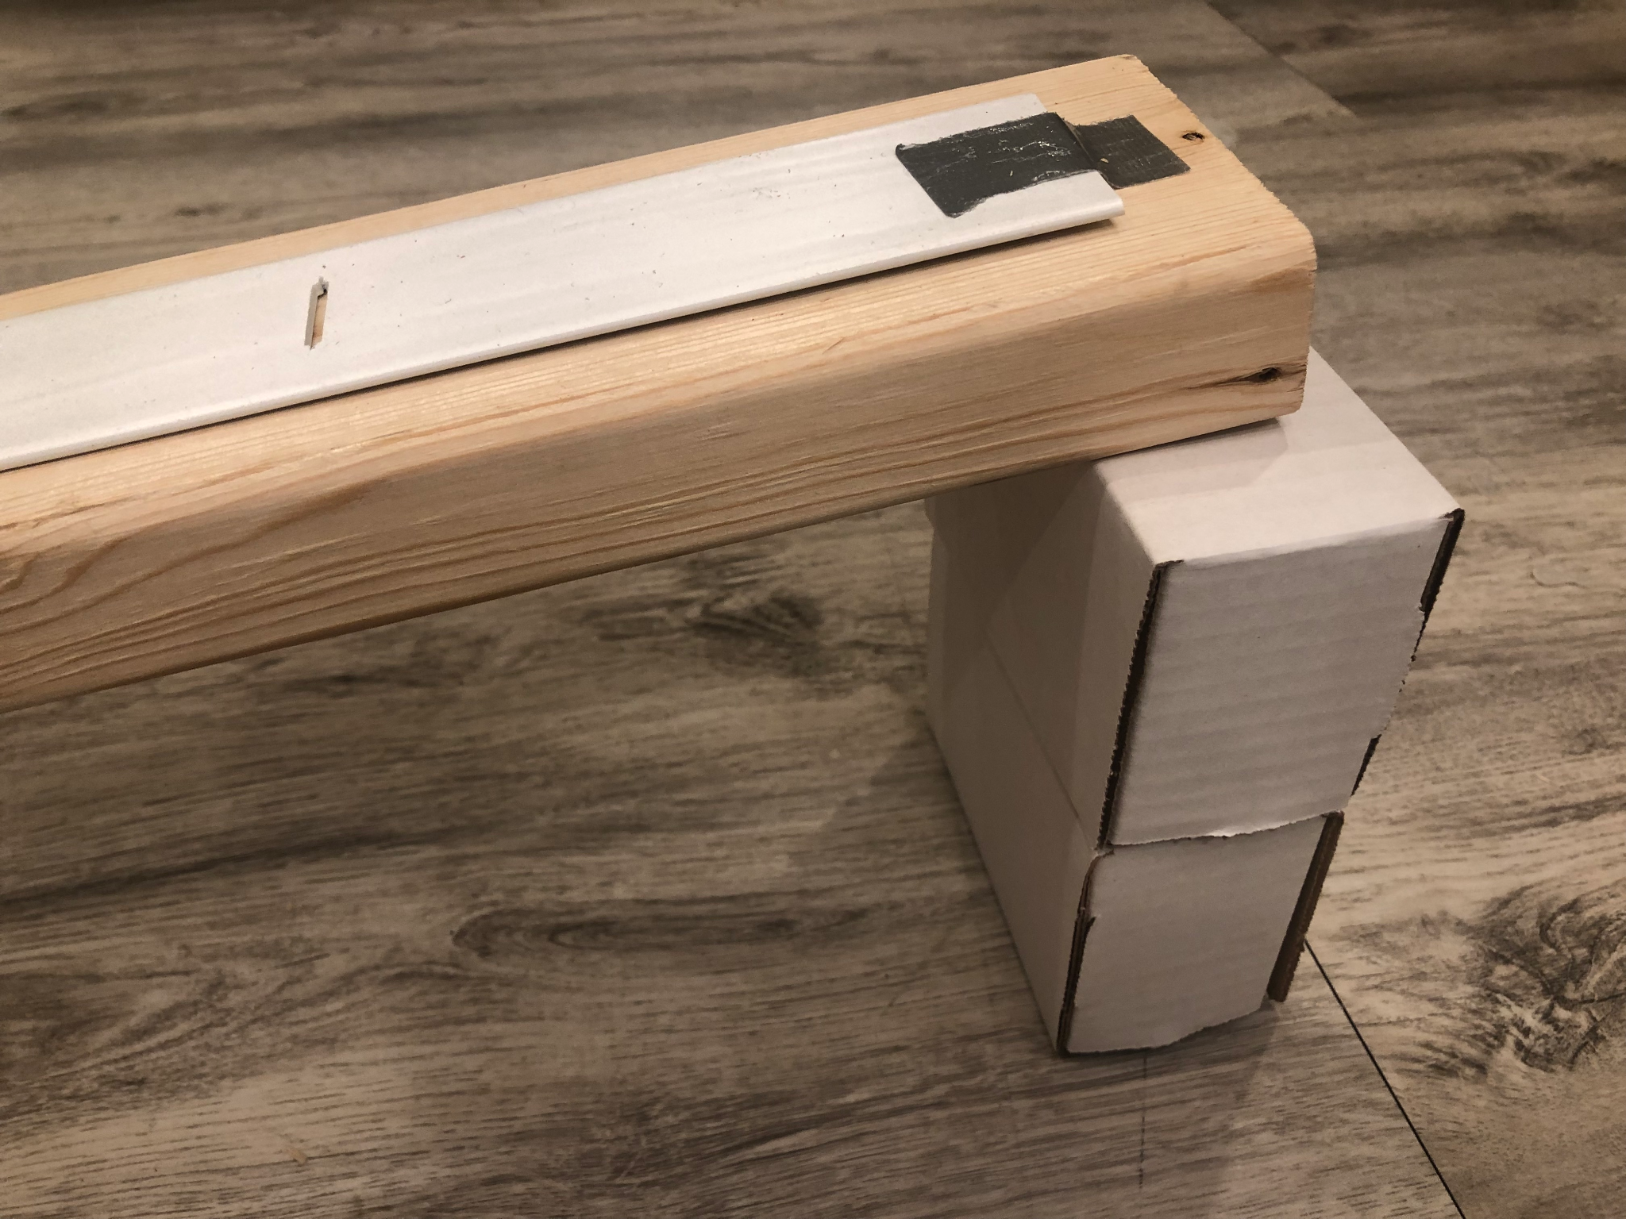
Considering Sources of Error
Slide L
On Your Own
Make a quantitative prediction: How would doubling the force on the cart affect the time it takes to reach a velocity of zero going up the second ramp?
Notes:
Make predictions about the force and time relationship. Present slide L. Say, We said before that the magnitude of the unbalanced force component will increase if we increase the angle of the ramp. On the board, sketch a force vs. time graph (force is negative).
Use it to show the force acting on the cart would be constant over time. Show a second line on the same axis that represents a higher force for an increased angle (a second constant line in a different color).
Distribute the handout and ask students to write their predictions to the question on the slide:
How would doubling the amount of force on the cart affect the time it takes to reach a velocity of zero going up the second ramp?
After a minute, invite them to share their predictions.

Slide 12

Carry out an investigation
Slide M
With your group
Review the Calibration Procedures
Carry out your experiment for the different braking ramp heights (3.5 inches, 4.5 inches, 5.5 inches and 7 inches).
Assign one person to use CODAP to analyze your data from each condition (Part 4)
Notes:
Distribute experimental and calibration procedures. Present slide M. Say, Let’s investigate our predictions. Distribute materials to each group, and a copy of the reference. This document will provide students a list of calibration protocols intended to obtain more reliable data.
Distribute a copy of the handout to every student, as you might want to encourage every person to collect the data obtained in the groups they work with. Orient them to Part 2 of the handout, and ask them to record their data in the table. Share the link for accessing CODAP video in order to analyze the data and identify outliers.
Carry out an investigation. Refer to the materials preparation section for instructions on how to set a workstation. Distribute materials to groups, and use the remaining time to conduct this investigation. Support groups as they record their data, making sure they are collecting multiple Δt per trial. Help those groups that are having difficulties introducing their results in CODAP.
Once students have decided they have collected enough data, ask them how they have reached this decision. Look for groups to mention that they conducted as many trials as they could to reduce the variability in their results.

Slide 13
Navigate
Slide N
Turn and Talk
How certain are you of your group’s individual results?
Should we expect other groups to have the same results from the same conditions?
What might merging the data from all the groups together help us see?
Be ready to share your ideas with the class
Notes:
Remind the class where we left last time. Present slide N. Say, Last class we all conducted the same investigation where we released a cart down a ramp and used a second ramp to change the force acting on the cart. We measured the time it would take the cart to go up that second ramp. Use the slide prompts to elicit student ideas about the reliability of their results first as a turn and talk, then as a class. See the prompts in the teacher guide for support.

Slide 14
Record Results from Investigation
Slide O
With your group
Add your group’s related force and Δt results to the class data chart.
Notes:
Interpret results as a whole class. Instruct students to sit with their group from last class and to bring the handout, where they collected the data from last class. Present slide O and sketch three tables on the board like the one below, one for each ramp height tested. Invite groups to write down their results in each table.

Slide 15
Share Main Findings from Investigation
Slide P
With your group
Determine whether each data set has a relatively small spread and the median is similar, OR whether we want to use CODAP to remove any potential outliers first.
Record the resulting median for F and Δt for each ramp condition.
Be ready to share your ideas with the class
Notes:
Present slide P. Ask groups to use the results shown on the tables to determine whether each data set has a relatively small spread and the median is similar, or whether they want to use CODAP to remove any potential outliers first. After a couple of minutes, invite groups to share their ideas with the class. If the class decides to remove potential outliers using CODAP for one or all the ramp height conditions tested, assign three groups to collect the results each group measured for one of the ramp heights and introduce them in CODAP. Then invite these three groups to share their findings. Write a summary of Δt and force from the class results.

Slide 16

Making Predictions
Slide Q
With a Partner
Compare the quantitative predictions you recorded earlier for this question: How would doubling the amount of force on the cart affect the time it takes to reach a velocity of zero going up the second ramp?
Did our class results support or refute your prediction? Record your claim in part 5 of your handout.
Be ready to share your ideas with the class
Notes:
Present slide Q. Ask students to return to their original seats and work with a partner in order to work on the slide prompts:
Compare the quantitative predictions you recorded earlier for this question: How would doubling the amount of force on the cart affect the time it takes to reach a velocity of zero going up the second ramp?
Did our class results support or refute your prediction?
Invite students to share their conclusions. Look for some groups to suggest that the results supported their predictions.

Slide 17

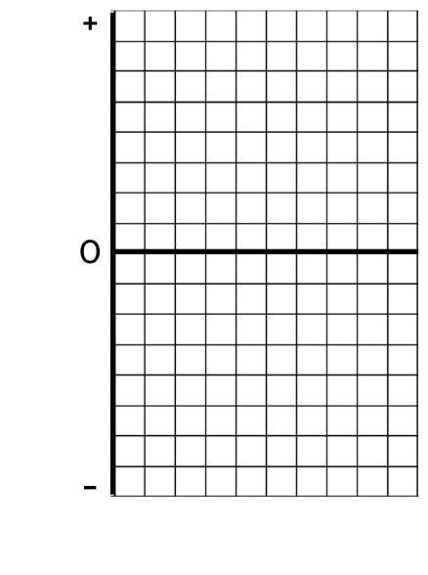
Represent the Change in Momentum
Slide R
On your own
Is there a mathematical relationship (or approximate one) between these two variables (F and Δt)?
Develop an area based representation of the data for all of the ramp heights our class tested to help explore this question further.
Notes:
Motivate the need to further explore the mathematical relationship. Present slide R. Say, Our predictions seem to suggest that many of us think there is a mathematical relationship between force and Δt. Last time we used a grid representation to investigate the relationship between mass and velocity. Let’s use a similar representation to further explore the relationship between time and force.

Slide 18
Represent the Change in Momentum
Slide S
With your class
What do we know about the momentum of the cart for the three ramp heights we investigated?
Based on our grid models for Force and Δt, is there a mathematical relationship (or approximate one) between these two variables?
Are there any limitations from our investigation that could be affecting the results we obtained?
Notes:
Represent the change in momentum. Present slide S. Distribute the handout to every student. To model how to use the grid representation, use the mean Δt and force values from the lowest height condition that was investigated.
Represent additional force-time relationships. Ask students to develop the grid models and calculate the corresponding areas using the results from the additional ramp heights investigated. Give them 5 minutes to complete this task.
Make sense of the grid representation. Say, We started this investigation because we wanted to explore the relationships between change in momentum, the force acting on an object, and the time this force was applied. See the prompts in the teacher guide for support.
Say, The momentum of the cart was the same for all three conditions, and in all three conditions it changed to zero, but this change happened sooner when the force was higher. This seems very productive, but we are still unsure about the nature of the mathematical relationship between force and time in all three cases.

Slide 19

Slide T
Navigate
With your class
What were the biggest challenges measuring the time and force with more precision during our investigation?
On your own
If we could repeat this experiment, what could we do to obtain more reliable measurements of time and force?
Be ready to share your ideas with the class next time!
Notes:
Discuss issues of accuracy of data. Present slide T. Say, Sometimes, when the data doesn't show a clear pattern, scientists need to decide (1) whether they still have some gaps in their understanding of the phenomenon, (2) whether the current model they have is limited and does not help them make sense of the data, or whether there are reasons to believe that the data that was collected lacked some accuracy due to the difficulty of measuring the variables of interest.
Use the slide prompts to elicit student ideas about issues of accuracy and brainstorm strategies to collect more reliable measurements.
What were the biggest challenges measuring the time and force with more precision?
If we could repeat this experiment, what could we do to obtain more reliable measurements of time and force? Accept all responses.
Collect handout for feedback. Collect the handout to provide feedback on this assessment opportunity.

Slide 20
Slide U
Navigate
With your class
If we could repeat the experiment we conducted last time, what could we do to obtain more reliable measurements of time and force?
Notes:
Brainstorm ideas for collecting more precise data. Present slide U. Instruct students to use the ideas they recorded in their science notebook. Use the slide prompt to elicit student ideas: See the prompts in the teacher guide for support.

Slide 21
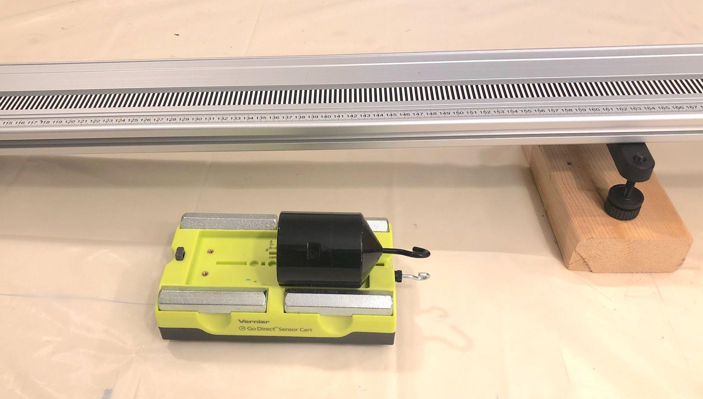
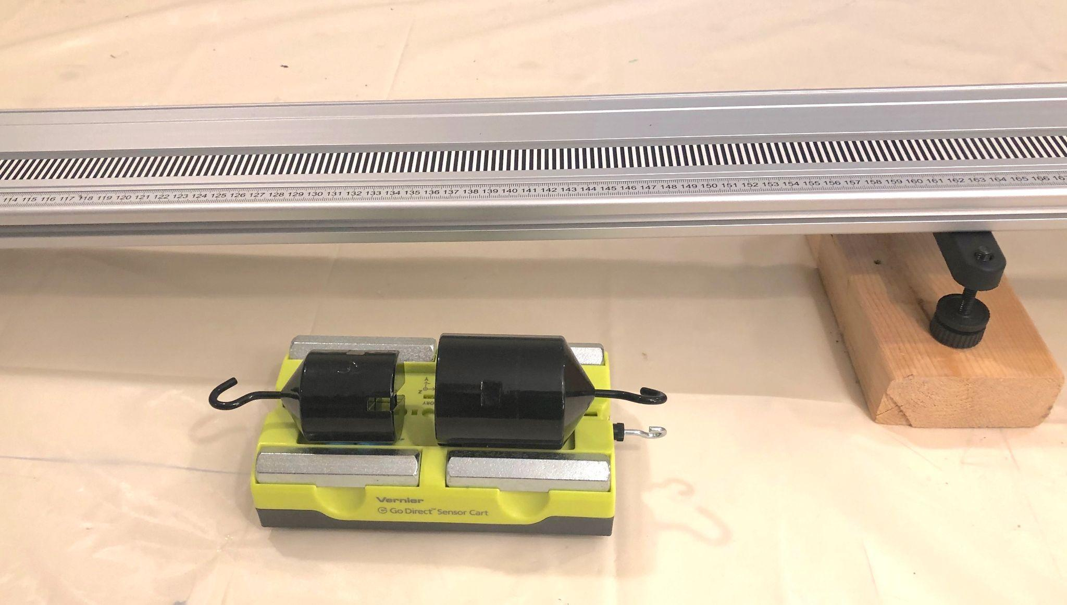
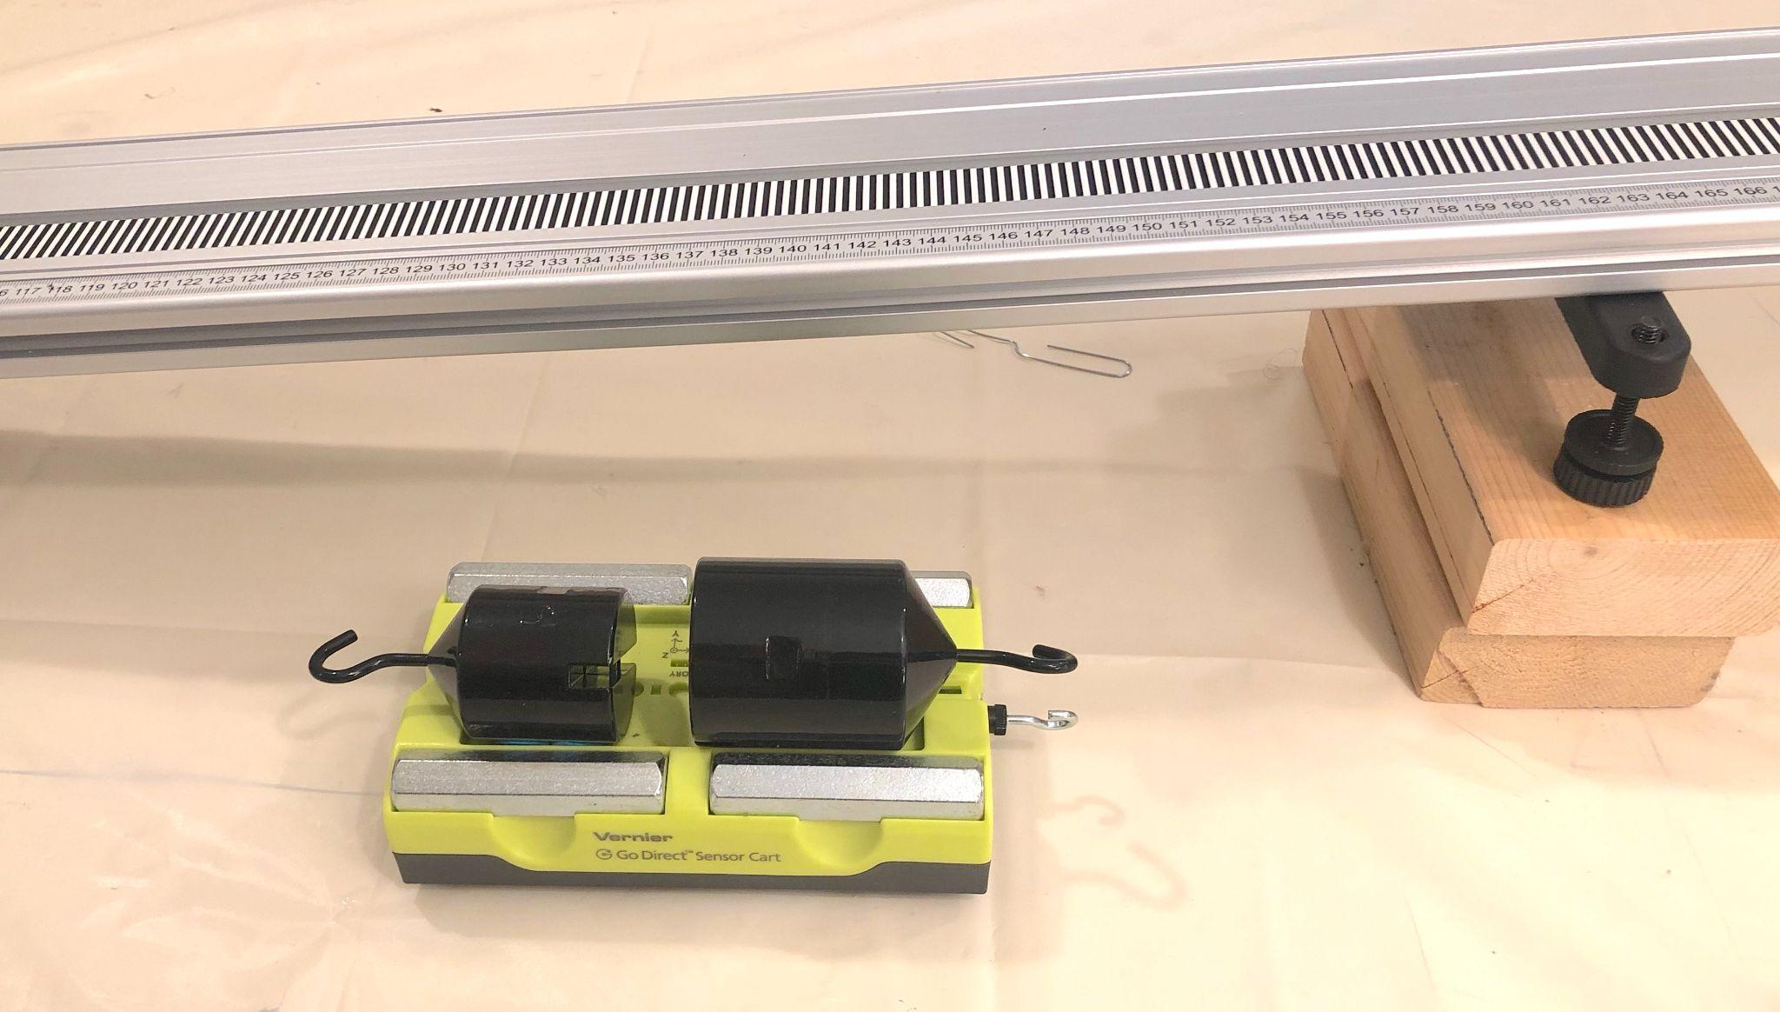
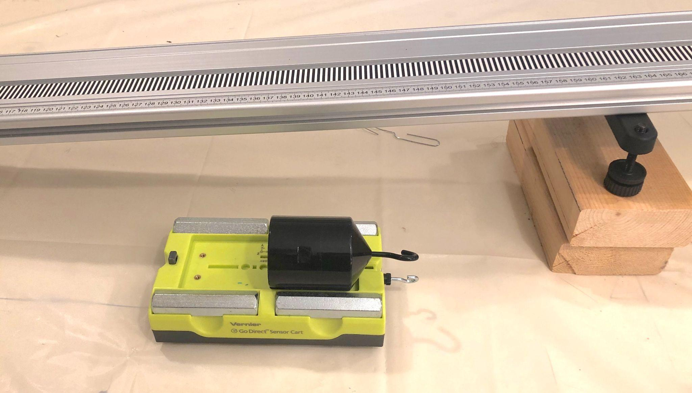
Consider System for Data Collection
Slide V
With Your Class
Watch a short video to orient to the system used to collect additional data for these four conditions:
Condition 1:
Cart mass = 1.80 kg
1 block ramp incline
Condition 2:
Cart mass = 2.30 kg
1 block ramp incline
Condition 3:
Cart mass = 2.30kg
2 block ramp incline
Condition 4:
Cart mass = 1.80 kg
2 block ramp incline
Notes:
Orient students to the system used to collect additional data. Present slide V and say, We are going to extract data from four additional conditions investigated using carts that have more sensitive sensors, so they can collect more precise data to explore this relationship more closely. Describe the four conditions presented in the slide, mentioning that in all four conditions, the cart was launched from the same starting point. Reproduce the video to give students an idea of how the tests were carried out.
Say, Let’s divide up into different groups, each exploring a couple of conditions.

Slide 22
Collecting Additional Data
Slide W
With a Partner
Identify the following in the two conditions you were assigned:
The mass of the cart (m)
Velocity of the cart at one point in time.
Velocity of the cart cart at another point in time.
The change in velocity (Δv) between these 2 points
The difference in time (Δt) between these two points.
The average gravitational force (F) acting on the cart parallel to the ramp over this time.
Notes:
Describe data collection task. Present slide W. Distribute the handout. Ask students to collect their data in their notebooks or on the handout. You can instruct students to complete this task on their own, or to work with a partner, each analyzing a different video.
Cue students to annotate the following pieces of information they will need to extract from the videos they will watch for each condition:
The mass of the cart (m)
Velocity of the cart at one point in time.
Velocity of the cart cart at another point in time.
The change in velocity (Δv) between these 2 points
The difference in time (Δt) between these two points.
The average gravitational force (F) acting on the cart parallel to the ramp over this time.

Slide 23
Represent the Change in Momentum
Slide X
With a Partner
Determine whether there is mathematical relationship (or approximate one) between m, Δv, F and Δt for each condition.
Create an area based representation of m and Δv on one grid.
Create an area based representation of F and Δt on the other grid.
Notes:
Use grid representation to identify mathematical relationships among variables. Present slide X. Say, Last time we developed a mathematical model, shifting the type of representation we used seemed helpful. Let’s reuse those grids again to see if they can help us make progress on our question about whether there is a mathematical relationship between the four different variables you identified for each condition.
Instruct students to use the second page of the handout for this task. They might want to use a calculator to find the value of the areas.

Slide 24
Develop a Mathematical Model
Slide Y
With your class
Was there a mathematical relationship (or approximate one) between m, Δv, F and Δt for none, some, or all of the four conditions?
Notes:
Discuss patterns among the areas. Present slide Y. Use the slide prompt to elicit student ideas:
Was there a mathematical relationship (or approximate one) between m, Δv, F and Δt for none, some, or all of the four conditions?
Check with each group until you establish that there appears to be equivalent areas on the two grids for every condition (all four) tested.

Slide 25
Use Mathematical Thinking
Slide Z
With a Partner
Rearrange the 4 variable cards and as many of the gray operation cards as needed into an equation to represent the mathematical relationship that seems to connect these variables.
Use the values for m, Δv, F and Δt you obtained from each condition to test if both sides of your equation are equal.
Be ready to share your model with the class
Notes:
Construct a mathematical model. Present slide Z. Say, The new data graphed on these grids has helped us identify a very close relationship among these variables. Let’s see if we can identify a mathematical relationship that can help us explain a wide range of collisions. Distribute the handout and scissors to each pair of students. Suggest that we try rearranging the variable cards to represent the mathematical relationship that seems to connect these variables.
Round Robin Share out. Give students a few minutes to work with rearranging the cards with a partner. After this time, ask them to share their answers. Invite a group of volunteers to share. Write the equation they suggest on the board, and ask the rest of the class:
Did any other group find the same relationship?
Who found a different mathematical relationship?
Repeat this process until all groups have shared their answers. Look for the class to build the equation shown below. It is okay if students propose this equation in a different arrangement. Record these variations in the variable arrangements on the board.

Slide 26
Develop a Mathematical Model
Slide AA
With your class
(How) can we describe in words what our proposed mathematical model means?
Notes:
Describe the meaning of the new mathematical relationship. Present slide AA. Use the first prompt to invite students to describe in their own words what each side of the equation says. See the prompts in the teacher guide for support.
Synthesize these ideas on chart paper and title it “Momentum Change”. You will continue using this poster in future lessons to guide discussions, elicit student ideas, and scaffold sense making.

Slide 27
Evaluate our Models
Slide BB
With your Class
Look back at our mathematical model charts. Which model best helps us predict the outcome of the following collisions:
Scenario A: A car of 3,000 kg traveling at a speed of 20 m/s collides with a car of 1,500 kg traveling at the same speed but in the opposite direction.
Scenario B: A car of 3,000 kg traveling at a speed of 20 m/s collides with a large concrete wall.
Notes:
Present slide BB. Say, Now we have two different models to make sense of the change in momentum that objects experience, let’s see which model best helps us predict the outcome of the following collisions. Ask students to use their notebooks to write their ideas. Invite them to use the grid models from the handout if they feel stuck. See the prompts in the teacher guide for support.

Slide 28
Consider momentum factors
Slide CC
On Your Own
Would you rather be hit by a slow car with a low mass (low momentum) or a fast car with a high mass (high momentum)?
Be ready to share your responses with the class
Notes:
Motivate the need to investigate factors that reduce momentum. Present slide CC. Use the slide prompts to elicit student ideas. Ask them to write their answers in their science notebooks.
Would you rather be hit by a slow car with a low mass (low momentum) or a fast car with a high mass (high momentum)?
Look for ideas about how if we have less change in momentum, we have less force. Point back to the equation we developed relating momentum and force if students need scaffolding here.
When students suggest that less change in momentum means less force, ask, Why is less force a good thing?
Guide students to suggest that we think that the force is what determines the risk to the car and person in it.

Slide 29
Consider momentum factors
Slide DD
With your Class
What determines how much momentum can change for a vehicle in a collision?
Notes:
Present slide DD. Say, We want to reduce the change in momentum in a collision for each vehicle. Because that will reduce the force. What determines how much momentum can change for a vehicle in a collision?
Look for ideas about starting masses and velocities at the moment of collision.
Say, The momentum of vehicle A is going to determine the change of momentum of vehicle B and vice-versa. So we want to reduce the initial momentum of both vehicles. Let’s take a moment to reflect on these factors and their connections to the outcomes of vehicles in a collision.

Slide 30
Navigate
Slide EE
On Your Own
How does our mathematical model help us inform our thinking about:
The factors we could change (as drivers) to safely reduce the momentum in a collision?
Additional factors we could change as engineers or as a society to try to reduce the momentum of vehicles involved in collisions?
Be ready to share your responses with the class
Notes:
Present slide EE. Give students a moment to consider the following questions. Ask students to record their thinking in their notebooks.
How does our mathematical model help us inform our thinking about:
The factors we could change (as drivers) to safely reduce our initial momentum in a collision?
Additional factors we could change as engineers or as a society to try to reduce the momentum of vehicles involved in collisions?

